Slide 1


Air Liquide S.A. - EPA:AI
Equity Research Report
07/04/2026

Slide 2
Arial Slide Title – 24
Content/Section Title Text – 14
Bullet and Subtitle Text – 12
Chart, Profile, and Currency Text – 10
Agenda
Normal shapes w/ text
Outline: black, ½ pt.
1
Company Overview
204 – 209 – 215
2
Industry Overview
3
Investment Thesis
72 – 80 – 89
4
Valuation
94 – 124 – 158
5
Catalysts and Risks
6
Recommendation
17 – 61 – 99

Slide 3
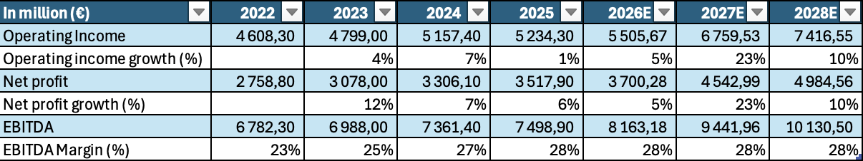
Arial Slide Title – 24
Content/Section Title Text – 14
Bullet and Subtitle Text – 12
Chart, Profile, and Currency Text – 10
Operating Forecast
Normal shapes w/ text
Outline: black, ½ pt.
204 – 209 – 215
Revenue drivers:
For Marvin or whoever wants to do it
72 – 80 – 89
94 – 124 – 158
17 – 61 – 99
ESSEC Capital Investments Club

Slide 4
Arial Slide Title – 24
Content/Section Title Text – 14
Bullet and Subtitle Text – 12
Chart. Profile. and Currency Text – 10
Agenda
Normal shapes w/ text
Outline: black. ½ pt.
1
Company Overview
204 – 209 – 215
2
Industry Overview
3
Investment Thesis
72 – 80 – 89
4
Valuation
5
Catalysts and Risks
94 – 124 – 158
6
Recommendation
17 – 61 – 99
ESSEC Capital Investments Club

Slide 5
Arial Slide Title – 24
Content/Section Title Text – 14
Bullet and Subtitle Text – 12
Chart, Profile, and Currency Text – 10
Agenda
Normal shapes w/ text
Outline: black, ½ pt.
1
Company Overview
204 – 209 – 215
2
Industry Overview
3
Investment Thesis
72 – 80 – 89
4
Valuation
94 – 124 – 158
5
Catalysts and Risks
6
Recommendation
17 – 61 – 99
ESSEC Capital Investments Club

Slide 6
Arial Slide Title – 24
Content/Section Title Text – 14
Bullet and Subtitle Text – 12
Chart, Profile, and Currency Text – 10
Investment Thesis
While the market focuses on volumes, Air Liquide is optimizing its profitability through its ADVANCE strategic plan. The digitization of control centers and the energy efficiency of air separation units are driving an expansion of the operating margin (targeted at +200 bps for 2025–2026).
This rigorous management, combined with a dividend and bonus share distribution policy that has been uninterrupted for 30 years, creates a positive risk asymmetry for long-term investors.
Operational Excellence and Margin Leverage (ADVANCE Plan)
Normal shapes w/ text
Outline: black, ½ pt.
Driving the Energy transition (“Hydrogen-Native” strategy)
Air Liquide is no longer just a gas supplier, but a pivotal technology platform for decarbonization. The widespread integration of renewable hydrogen and carbon capture and storage (CCS) solutions enable the group to turn regulatory constraints into growth drivers.
With major projects such as Normand'Hy, the group is securing massive subsidies and exclusive supply contracts, ensuring cash flow visibility for over 15 years.
204 – 209 – 215
72 – 80 – 89
Dominance in the High-Tech and Electronics markets
Contrary to fears of an industrial slowdown, the Electronics division benefits from a significant technological barrier to entry. The supply of ultra-pure gases for the manufacture of next-generation semiconductors is driven by global “reshoring” (CHIPS Act, EU Chips Act).
The expansion of capacity by strategic clients such as TSMC and Intel should enable the capture of additional market share by 2027, creating a positive decoupling from traditional economic cycles.
94 – 124 – 158
17 – 61 – 99
ESSEC Capital Investments Club

Slide 7
Arial Slide Title – 24
Content/Section Title Text – 14
Bullet and Subtitle Text – 12
Chart, Profile, and Currency Text – 10
Marvin – done except brokers
Agenda
Normal shapes w/ text
Outline: black, ½ pt.
1
Company Overview
204 – 209 – 215
2
Industry overview
3
Investment Thesis
72 – 80 – 89
4
Valuation
94 – 124 – 158
5
Catalysts and Risks
6
Recommendation
17 – 61 – 99
ESSEC Capital Investments Club

Slide 8
Arial Slide Title – 24
Content/Section Title Text – 14
Bullet and Subtitle Text – 12
Chart, Profile, and Currency Text – 10
Broker estimates
Broker Estimates | Target Prices ($) | Upside (%) | Rating
Evercore (11/02/2026) | $85.00 | +10.7% | Buy
UBS (11/02/2026) | $87.00 | +13.3% | Strong Buy
Jefferies (11/02/2026) | $87.00 | +13.3% | Strong Buy
Wells Fargo (09/02/2026) | $87.00 | +13.3% | Buy
Citigroup (11/02/2026) | $87.00 | +13.3% | Strong Buy
JP Morgan(11/02/2026) | $83.00 | +8.06% | Buy
RBC Capital (11/02/2026) | $87.00 | +13.3% | Buy
Overall average (23 analysts) | $81.93 | +6.67% | Outperform
Normal shapes w/ text
Outline: black, ½ pt.
204 – 209 – 215
72 – 80 – 89
94 – 124 – 158
17 – 61 – 99
ESSEC Capital Investments Club
Notes:
16

Slide 9
DCF Model Output
WACC Assumptions
Cost of Debt
3.01%
As of December 2025, the cost of debt for AI was €291.4m, for a total book value of net debts of -€9.69bn
=> Cost of Debt = 0.291 / 9.69 = 3.01%.
Risk Free Rate
3.75%
We use here the French 10Y gov bond
Cost of Equity
5.98%
We use here a 2.90% market premium, the difference between the risk-free rate and the 10Y return average of the CAC40 Index and the CAPM model then:
Ke = Rf + β * (Rm - Rf) with an adjusted β= 0.65*0.67+0.33*1=0.77
Weight of debt
13.14%
Market cap : €103.86bn / Total debts : €13.65bn
Weight of debt = 13.65 / 103.86 = 13.14%
WACC
5.49%
WACC = (1- weight of debt) * Cost of Equity + weight of debt * Cost of Debt * (1 - Tax Rate)
= (1 – 13.14%) * 5.98% + 13.14% * 3.01% * (1 – 24.73%)
= 5.49%
17 – 61 – 99
ESSEC Capital Investments Club
Notes:
17

Slide 10
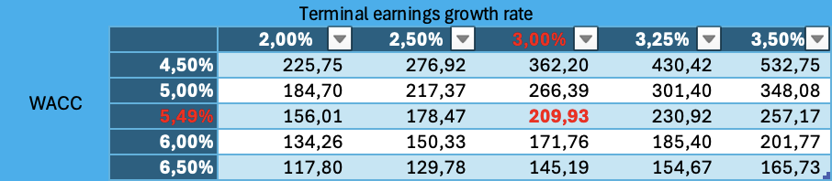
Arial Slide Title – 24
Content/Section Title Text – 14
Bullet and Subtitle Text – 12
Chart, Profile, and Currency Text – 10
DCF Model Output
Terminal Value – Perpetuity Growth Method
2025 FCF : EUR 3.46B
Normal shapes w/ text
FCF growth for the next 10Y : 3.5%
Baseline Terminal FCF Growth Rate: 3%
Baseline Terminal Value : EUR 106.31B
Diluted shares outstanding : 578m
Outline: black, ½ pt.
Net debt : EUR 9.69B
Baseline EV : EUR 131.02B
204 – 209 – 215
Implied Share Price from DCF
€209.93
Premium to Current Share Price
+%
72 – 80 – 89
Sensitivity Analysis
94 – 124 – 158
17 – 61 – 99
ESSEC Capital Investments Club
Notes:
17

Slide 11
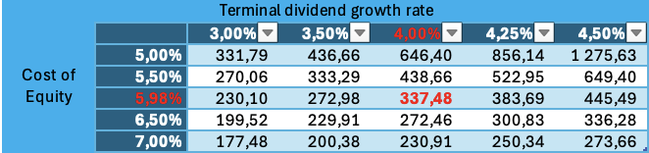
Arial Slide Title – 24
Content/Section Title Text – 14
Bullet and Subtitle Text – 12
Chart, Profile, and Currency Text – 10
DDM Model Output
Terminal Value – Gordon Growth Model
Dividend yield : 2.05%
Normal shapes w/ text
Dividends 2024 : €2.91
Estimated dividends :
 | 2025 | 2026 | 2027 | 2028 | 2029 | 2030 | 2031
dividends | 3,38 | 3,72 | 4,09 | 4,50 | 4,95 | 5,45 | 5,99
PV |  | 3,51 | 3,64 | 3,78 | 3,93 | 4,07 | 4,23
Outline: black, ½ pt.
Dividend growth rate perpetual : 4.00%
204 – 209 – 215
Cost of Equity: 5.98%
Implied Share Price from DDM
€337.48
Premium to Current Share Price
+%
72 – 80 – 89
Sensitivity Analysis
94 – 124 – 158
17 – 61 – 99
ESSEC Capital Investments Club
Notes:
17

Slide 12
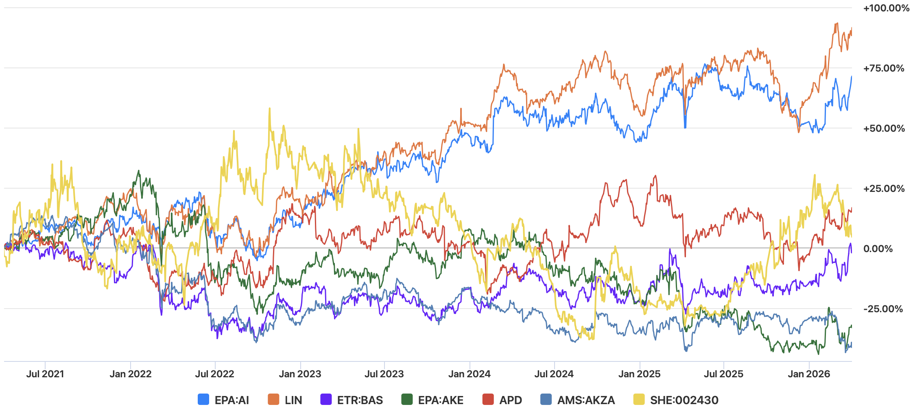
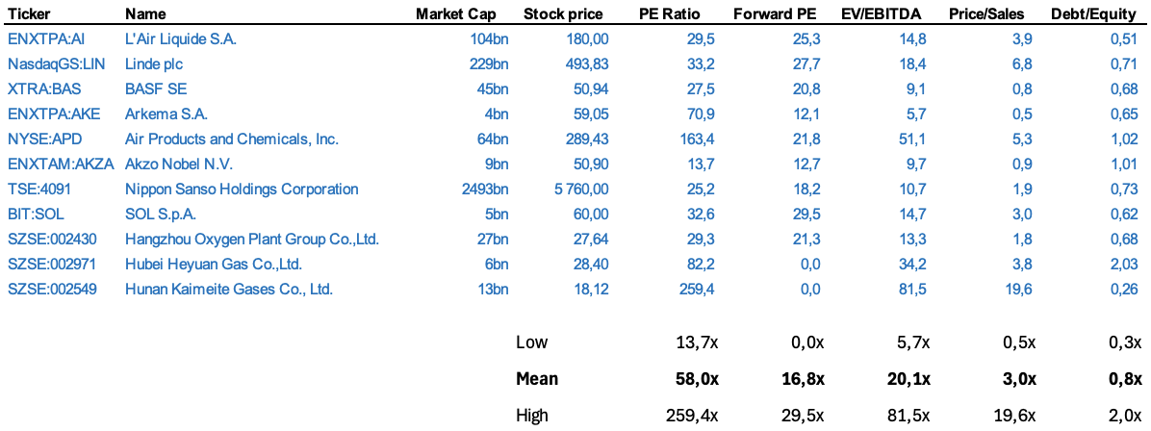
Arial Slide Title – 24
Content/Section Title Text – 14
Bullet and Subtitle Text – 12
Chart, Profile, and Currency Text – 10
Comparables Analysis
Key similarities: These firms manage mission-critical industrial gas portfolios spanning large-scale manufacturing, electronics, and increasingly, massive low-carbon hydrogen projects. Air Liquide can remain competitive by accelerating its transition toward the "hydrogen economy" while maintaining best-in-class margins in its traditional Industrial Merchant and Healthcare operations. Like Linde and Air Products, it invests heavily in high-purity gases for the semiconductor industry and carbon capture technologies, but its balanced strategy between long-term infrastructure assets and high-margin specialty gases helps it sustain strong returns while leading the global industrial decarbonization movement.
Normal shapes w/ text
Outline: black, ½ pt.
94 – 124 – 158
17 – 61 – 99
ESSEC Capital Investments Club
Notes:
16

Slide 13
Arial Slide Title – 24
Content/Section Title Text – 14
Bullet and Subtitle Text – 12
Chart, Profile, and Currency Text – 10
Comparables Analysis: Multiples Valuation
Normal shapes w/ text
 | PE Ratio | Forward PE | EV/EBITDA | Price/Sales
Air Liquide | 29,5x | 25,3x | 14,8x | 3,9x
Mean peers | 58,0x | 16,8x | 20,1x | 3,0x
xValuation (bn) | 204,15 | 144,65 | 151,06 | 81,69
price / shares | 353,24 | 250,28 | 261,38 | 141,36
Outline: black, ½ pt.
94 – 124 – 158
17 – 61 – 99
ESSEC Capital Investments Club
Notes:
16

Slide 14
Arial Slide Title – 24
Content/Section Title Text – 14
Bullet and Subtitle Text – 12
Chart, Profile, and Currency Text – 10
Agenda
Normal shapes w/ text
Outline: black, ½ pt.
1
Company Overview
204 – 209 – 215
2
Investment Thesis
3
Investment Thesis
72 – 80 – 89
4
Valuation
94 – 124 – 158
5
Catalysts and Risks
6
Recommendation
17 – 61 – 99
ESSEC Capital Investments Club

Slide 15
Arial Slide Title – 24
Content/Section Title Text – 14
Bullet and Subtitle Text – 12
Chart, Profile, and Currency Text – 10
Catalyst path
Horizon | Event catalyst | Expected impact
Q1 2026 | "Hard-to-abate" contract signings | Backlog Acceleration & Risk Reduction: Signing 15-20 year take-or-pay contracts with steel (Thyssenkrupp) and cement giants. This provides a massive boost to the investment backlog and proves that decarbonization is a concrete revenue stream. It mechanically lowers the equity risk premium in DCF models, as long-term cash flow visibility reaches record levels.
Q2 2026 | Commissioning of giant projects | The operational launch of units like Normand'Hy (200 MW electrolyzer) marks the shift from R&D to industrial scale. We expect an immediate uplift in the Large Industries segment's operating margin. This will also trigger the recognition of government operational subsidies (OPEX support), directly flowing into the EBITDA.
Q3 2026 | Central Bank pivot (ECB/Fed) | As a capital-intensive "Bond Proxy," Air Liquide is highly sensitive to interest rates. A pivot lowers the WACC (Weighted Average Cost of Capital), making future green projects more NPV-positive. Historically, lower rates trigger a rotation into high-quality yield stocks, driving a re-rating of the P/E multiple toward its 5-year high.
Q3 2026 | Acceleration of Electronics demand | The ramp-up of new semiconductor Giga-fabs (TSMC, Intel) in Arizona and Germany will spike demand for carrier gases and extreme-purity materials. Since the Electronics branch carries significantly higher margins than the group average, this "mix effect" will drive a disproportionate increase in net earnings per share (EPS).
Recurrent | Awarding of free shares | Usually executed on a 1-for-10 basis every two years. This operation technically lowers the price per share, increasing liquidity. Historically, the "dilution" is closed by the market within months due to the strong buy-side demand.
Normal shapes w/ text
Outline: black, ½ pt.
204 – 209 – 215
72 – 80 – 89
94 – 124 – 158
17 – 61 – 99
ESSEC Capital Investments Club

Slide 16
Arial Slide Title – 24
Content/Section Title Text – 14
Bullet and Subtitle Text – 12
Chart, Profile, and Currency Text – 10
Risks considerations
Risk Level | Risk Factor | Description & Impact Analysis
LOW | Regulatory Uncertainty | Minor delays in the application of public subsidies (e.g., EU hydrogen subsidies). The impact is limited because Air Liquide self-finances a large part of its R&D.
MEDIUM | Energy Volatility | A sudden surge in electricity or gas prices. Although "pass-through" protects margins, an extreme peak can create a quarterly cash flow mismatch.
MEDIUM | Capital Intensity | A prolonged maintenance of high interest rates by the ECB/Fed increases the cost of debt financing for new giant projects (electrolysers).
HIGH | Geopolitical Execution | A severe economic slowdown in China or major trade fragmentation. This would directly impact the volumes of the Industrial Merchant and Electronics divisions.
HIGH | Competition & Market Share | Commercial aggressiveness from Linde or Air Products on large semiconductor contracts ("Over-bidding"). This could force Air Liquide to reduce its prices to retain its key customers.
Normal shapes w/ text
Outline: black, ½ pt.
204 – 209 – 215
72 – 80 – 89
94 – 124 – 158
17 – 61 – 99
ESSEC Capital Investments Club

Slide 17
Arial Slide Title – 24
Content/Section Title Text – 14
Bullet and Subtitle Text – 12
Chart, Profile, and Currency Text – 10
Agenda
Normal shapes w/ text
Outline: black, ½ pt.
1
Company Overview
204 – 209 – 215
2
Investment Thesis
3
Investment Thesis
72 – 80 – 89
4
Valuation
5
Catalysts and Risks
94 – 124 – 158
6
Recommendation
17 – 61 – 99
ESSEC Capital Investments Club

Slide 18
Arial Slide Title – 24
Content/Section Title Text – 14
Bullet and Subtitle Text – 12
Chart, Profile, and Currency Text – 10
Price Target & Recommendation
Marvin (waiting for Bloomberg)
Price Target
We believe that under $80, KO is a low-risk play and therefore a buy for our core portfolio.
Our price target is $90, giving us a 17% upside, but this is a short to medium-term play.
A stop in the 64-year continuous increase in dividends is where we could consider selling before our price target.
We put a stop loss at $65.
Normal shapes w/ text
Valuation Summary
Analysis | Price | Weight
Current price | $76.81 | 10%
Brokers | $81.93 | 20%
Comparables | $90.71 | 20%
DCF | $62.61 | 20%
DDM | $118.02 | 30%
Target Price | $90.14 | 100%
Outline: black, ½ pt.
204 – 209 – 215
72 – 80 – 89
94 – 124 – 158
17 – 61 – 99
ESSEC Capital Investments Club
Notes:
21

